Slide 1
Mikhail Abramovich Roytberg
27 XII 1952 – 16 VII 2017

Slide 2
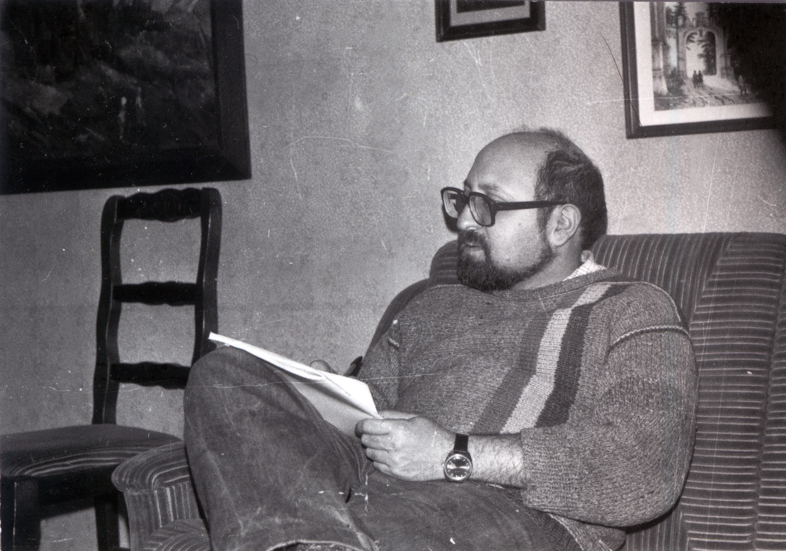
Before bioinformatics

Slide 3
LA, Venice Beach, ca. 1999 (with Andrei Mironov, Pavel Pevzner, Mikhail Gelfand et al.)

Slide 4
LA, ca. 1999 (with Andrei Mironov, Pavel Pevzner, Mikhail Gelfand)

Slide 5
Altai, 2002 – post-BGRS (with Vsevolod Makeev, Olga Kalinina et al.)

Slide 6
Altai, 2002 – post-BGRS

Slide 7
Altai, 2002 – post-BGRS (with Vasily Ramensky)

Slide 8
Altai, 2002 – post-BGRS

Slide 9
Altai, 2002 (pre-Katun)

Slide 10
Altai, 2002 (post-Katun)

Slide 11
Pyatnitskaya, New Year, ca. 2010

Slide 12
White Sea, 2009

Slide 13
White Sea, 2009 (with Alexei Kondrashov et al.)

Slide 14
Moscow, 2012 “Scientific column” (with Alexei Kondrashov)

Slide 15
Pushchino Winter Schools, 2000-2010’s

Slide 16
Pushchino Winter School, 2010’s (with Ivan Kulakovsky)

Slide 17
Pushchino Winter School, 2010’s

Slide 18
Pushchino Winter School, 2010’s

Slide 19
Pushchino Winter School, 2010’s

Slide 20
Pushchino Winter School, 2010’s

Slide 21
Pushchino Winter School, 2015?

Slide 22
Pushchino Winter School, 2010’s

Slide 23
Pushchino Winter School, 2010’s

Slide 24
Pushchino Winter School, 2010’s (with Peter Vlasov)

Slide 25
Pushchino Winter School, 2010’s (with Eugene Baulin)

Slide 26
Pushchino Winter School, 2010’s (with Fedor Kondrashov)

Slide 27
Pushchino, 2014 – SMTB (with Fedor Kondrashov and Mitya Kokorin)

Slide 28
Pushchino, 2015 – SMTB

Slide 29
Pushchino, 2015 – SMTB (with Maria Tutukina and Mikhail Gelfand)

Slide 30
Barcelona, 2016 – SMTB (with Fedor Kondrashov and Vladimir Gelfand)

